Slide 1
EE746 Neuromorphic Engineering Lecture 3a: Synapse
Udayan Ganguly
udayan@ee.iitb.ac.in
Feb, 14, 2020
This follows Purves Ch 5: Synaptic Transmission
Taylor book Ch 2.3 Basic Synaptic Mechanisms
You can also read http://icwww.epfl.ch/~gerstner/SPNM/node70.html a description on models

Slide 2
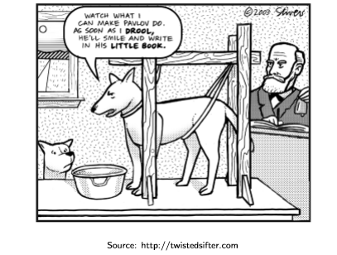
Goal of this Lecture
Why study synapses?
How does synapses work?
What are the synaptic learning rules? Memory
How to model synapses?

Slide 3
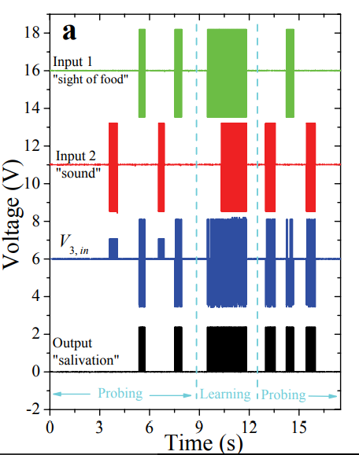
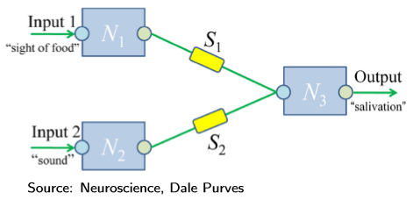

Synaptic Model of Learning / Memory
Source: arxiv.org/pdf/0905.2935
Local and cooperative / associative learning

Slide 4
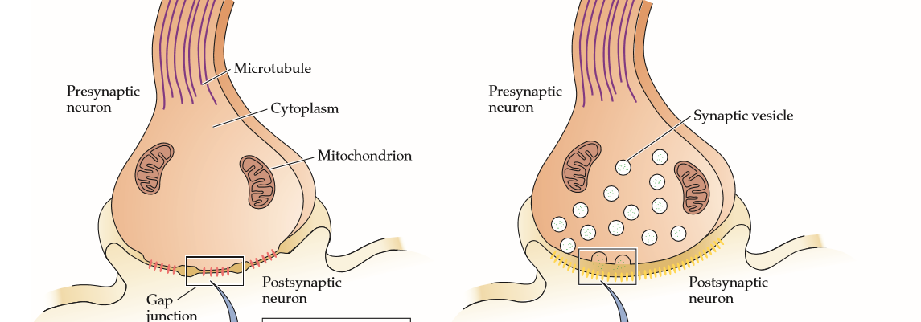
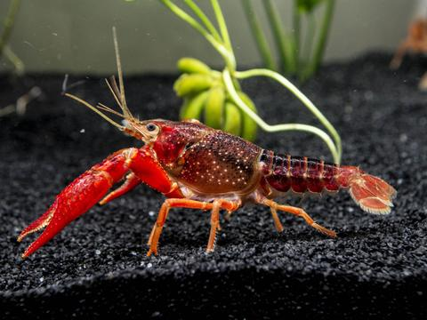
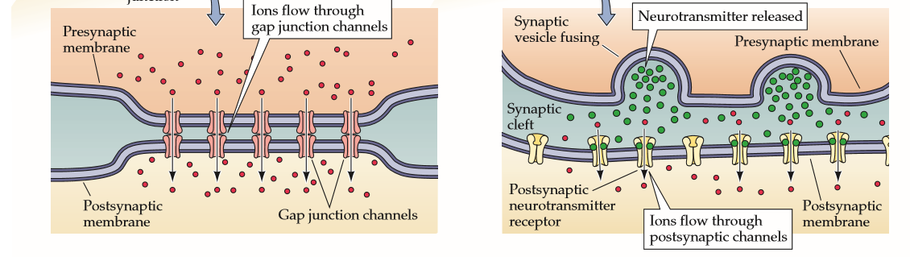
Electrical Synapse
Electrical: minority but found in all nervous systems
Passive current flow through ions;
Not prevalent!

Slide 5
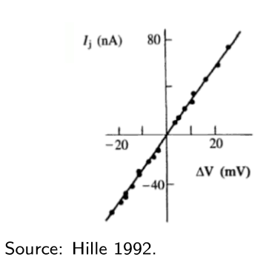
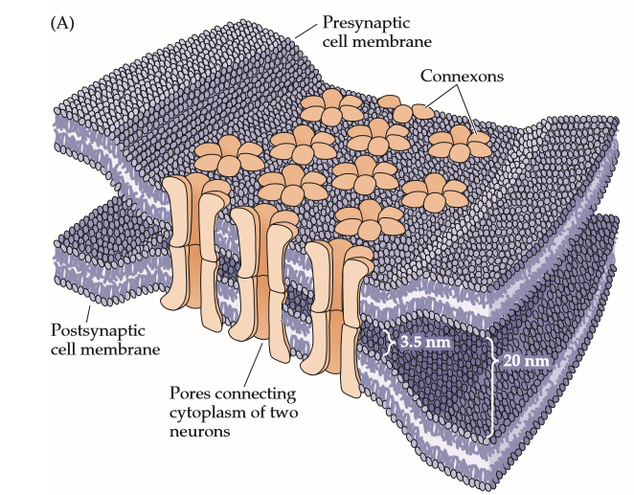
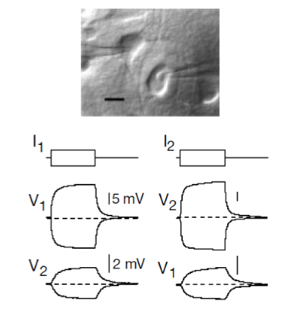
Electrical Synapses
Separation between neurons = 3.5 nm
High conductance pathway between two cells
Gap junction conductivity is symmetric
Sub-threshold currents in pre-synaptic neuron is transmitted to post-synaptic neuro
Source: Nature 402, 75-79 (1999)

Slide 6
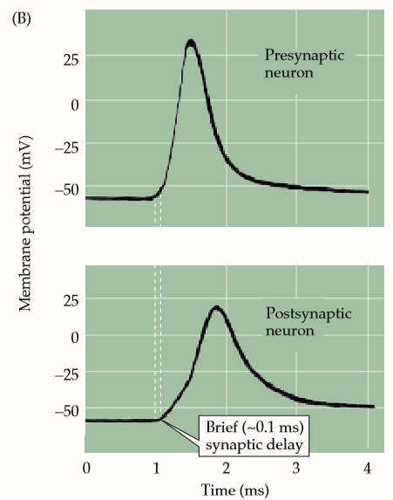
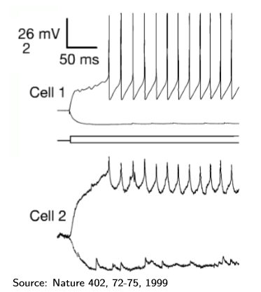
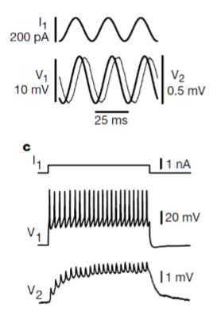
Coupling between neurons
Electrical gap junctions were discovered in crayfish
Pre neuron spike does not necessarily produce post neuron spike
There could be a delay
Delay is normally very small (0.1ms); which helps crayfish respond to threats faster

Slide 7
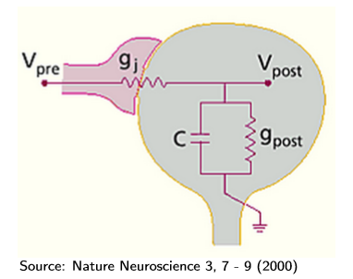
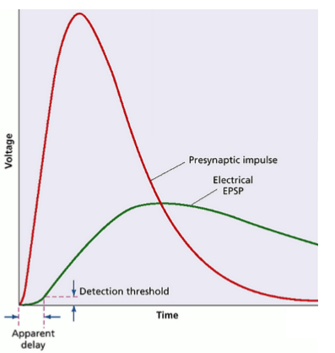
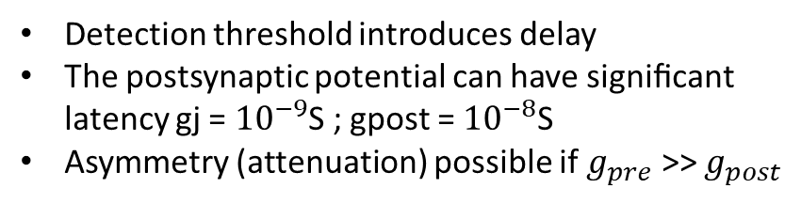
Model of a synapse
Q1: Why are the input/output peaks shifted?
Q3: At what condition and hence when does the output peak occur?
Q2 Please write down how to engineer independently
Peak EPSP
Delay in EPSP
Detection threshold introduces delay
The postsynaptic potential can have signiﬁcant latency gj = ${10}^{−9}$S ; gpost = ${10}^{−8}$S
Asymmetry (attenuation) possible if $g_{pre}$ >> $g_{post}$
Seeing is relieving: electrical synapses between visualized neurons | Nature Neuroscience
This is almost like post neuron is an extension of pre-neuron i.e. direct electrical connection

Slide 8
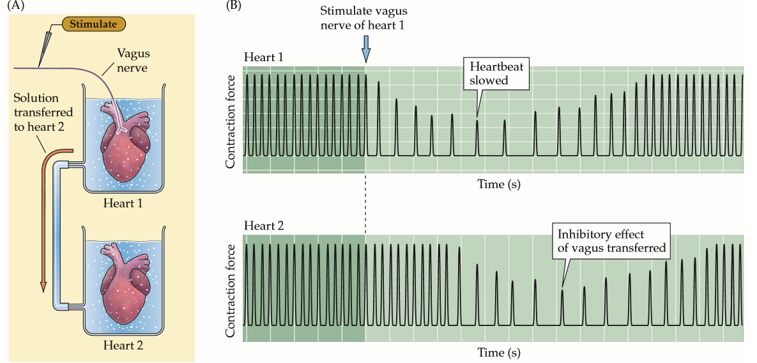
Proof of Existence of chemical signal
German physiologist Otto Loewi 1926.
Is synapse purely electrical? Or are there chemicals that produce signal transfer as well?
It is difficult to study chemical like NT unlike electrical signals (a) they are transient ; (b) to confuse further, electrical signal appears at both end. So is chemical signal connecting electrical signal?
Where the vagus nerve of an isolated frog’s heart was stimulated, the heart rate decreased (upper panel). If the perfusion fluid from the stimulated heart was transferred to a second heart, its rate decreased as well (lower panel). How will you test that it is not electrical?
Notes:
https://en.wikipedia.org/wiki/Otto_Loewi
On Easter Saturday 1921, Otto Loewi dreamt up the solution, got excited, in half-awake state noted the solution in great joy and went back to sleep. but could not read the notes in the morning. It was the longest day he had.
That night he has the same dream. This time he woke up to the lab and immediately did the experiment.
“ “The night before Easter Sunday of [1920] I awoke, turned on the light and jotted down a few notes on a tiny slip of thin paper. Then I fell asleep again. It occurred to me at 6.00 o’clock in the morning that during the night I had written down something important, but I was unable to decipher the scrawl. The next night, at 3.00 o’clock, the idea returned. It was the design of an experiment to determine whether or not the hypothesis of chemical transmission that I had uttered 17 years ago was correct. I got up immediately, went to the laboratory, and performed a simple experiment on a frog heart according to the nocturnal design.””
https://www.ncbi.nlm.nih.gov/pmc/articles/PMC4291908/

Slide 9
Two Synapse Types: Electrical & Chemical
Electrical: minority but found in all nervous systems
Chemical: Common
Passive current flow through ions;
Not prevalent!
Ion flow is modulated by neuro transmitters which open/close ion channels:

Slide 10
Electrical vs. Chemical Synapses
 | Electrical | Chemical
Occurrence | Ubiquitous but fewer in number | Majority but specialized with 100 NTs
Signal Direction | Bi-directional / symmetric | Unidirectional: Pre to post neuron
Speed | Fast due to direct contact | Has delays and more complex dynamics with different stages
Control |  | Excitatory vs. inhibitory
Adaptation |  | Plasticity
10-50x slower
0.1ms
1-5ms

Slide 11
Chemical Synapse
Information transmission can happen in only one direction unidirectional transmission.
Chemicals called neurotransmitters stored in synaptic vesicles “carry” the information.
Physical separation of neurons is about 20-40nm. (cf. 3.5nm electrical synapse)
Transmission of information takes about 1-5ms. (cf. 0.1ms electrical synapse)
Response can be diﬀerent from the input - excitatory or inhibitory.
Synaptic strength can change plasticity

Slide 12
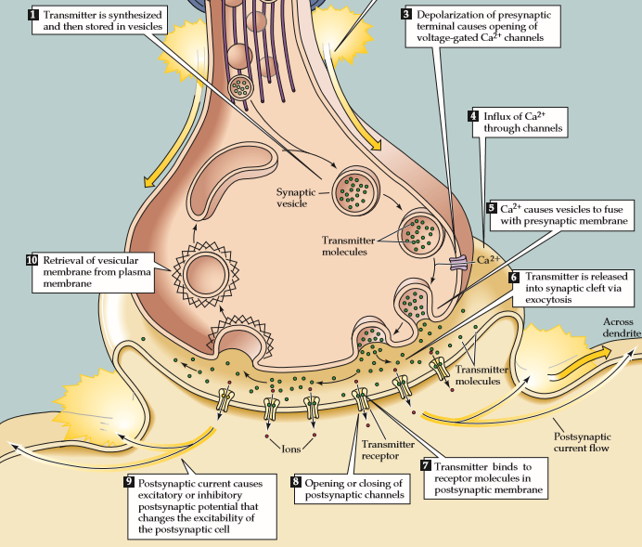
Details
Vesicles store NTs AcetylCholine, Dopamine, Norepinephrine, γ-aminobutyric acid (GABA), Glutamate
AP opens voltage gated Ca2+ channels.
Ca2+ causes vesicles to fuse with presynaptic membrane, and release of NTs.
NTs diﬀuse and bind to the receptors in post-synaptic membrane, leading to opening or closing of channels in the post-synaptic neuron.
Vesicular membrane is retrieved by the pre-synaptic membrane and reused.
Which is the slowest step?

Slide 13
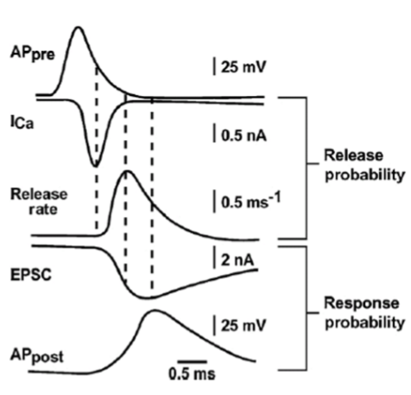
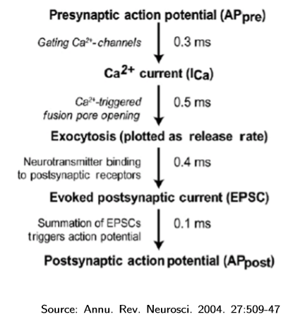
Timing Delay
How may steps is there between Exocytosis and EPSC?
Which is the slowest step?
Possibly diffusion of NT
Notes:
The synaptic transmission steps each have a delay mentioned. We don’t see a major different between them.
Why does this all have the similar time delay?
A discussion revealed two positions.
Biological intent: Biology likes to have each element minimized so as to speed up synaptic transmission. What is the incentive for evolution? Faster synapses are a premium advantage for survival. Nature would painstakingly over generations evolve the fastest overall synapse.
Microprocessor pipelining analogy: Each stage of a microprocessor is made equally fast overall. Slow stages are parallelized to compensate and enable similar throughput. There seems to be other information processing systems that subscribe to a similar strategy.

